Slide 1
Adaptive Clocking Techniques for SoC Supply Droop Response in Predictive 7nm CMOS
Dan Fritchman, Wahid Rahman
EE241B Final Project
UC Berkeley
May 4, 2020

Slide 2
Overview
Motivation
Adaptive clocking schemes
PLL-based adaptive clocking
Adaptive Clock Distribution (ACD)
PLL-based adaptive clocking in ASAP7
Simulation results
Summary

Slide 3
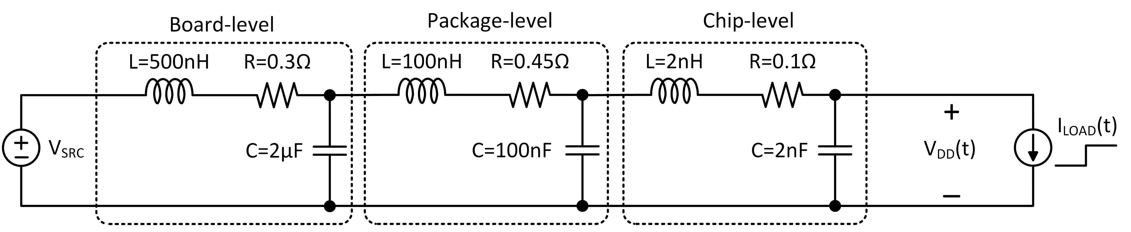
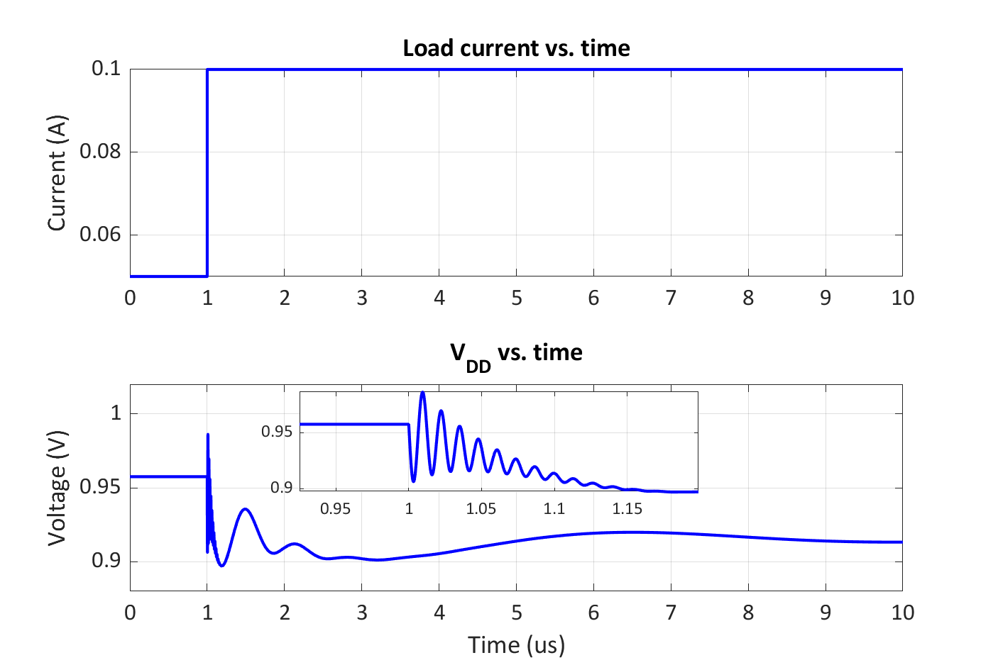
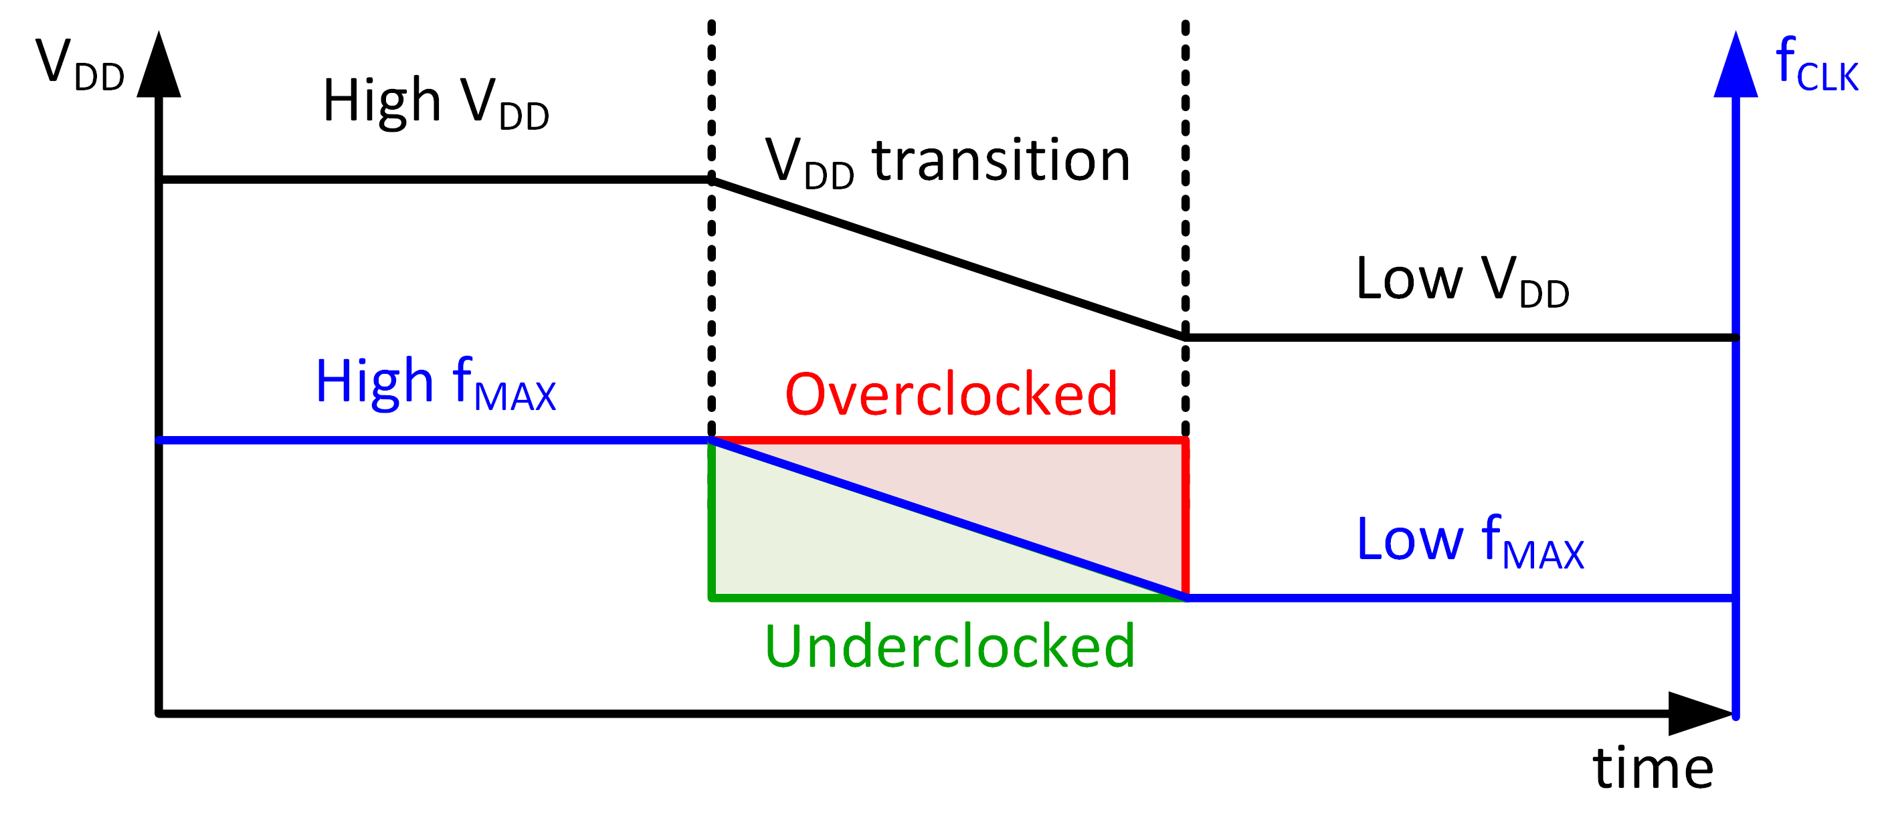

Motivation
Adapted from F. Ahmad et al. JSSC 2017
Adapted from T. Hashimoto et al. JSSC 2015
Power management in modern SoCs can enable/disable multiple cores, causing surge currents
Surge currents cause supply droops through L$\frac{di}{dt}$ ripples from power distribution network
Objective: Adapt SoC clocking in response to supply droops with minimal guardbanding

Slide 4
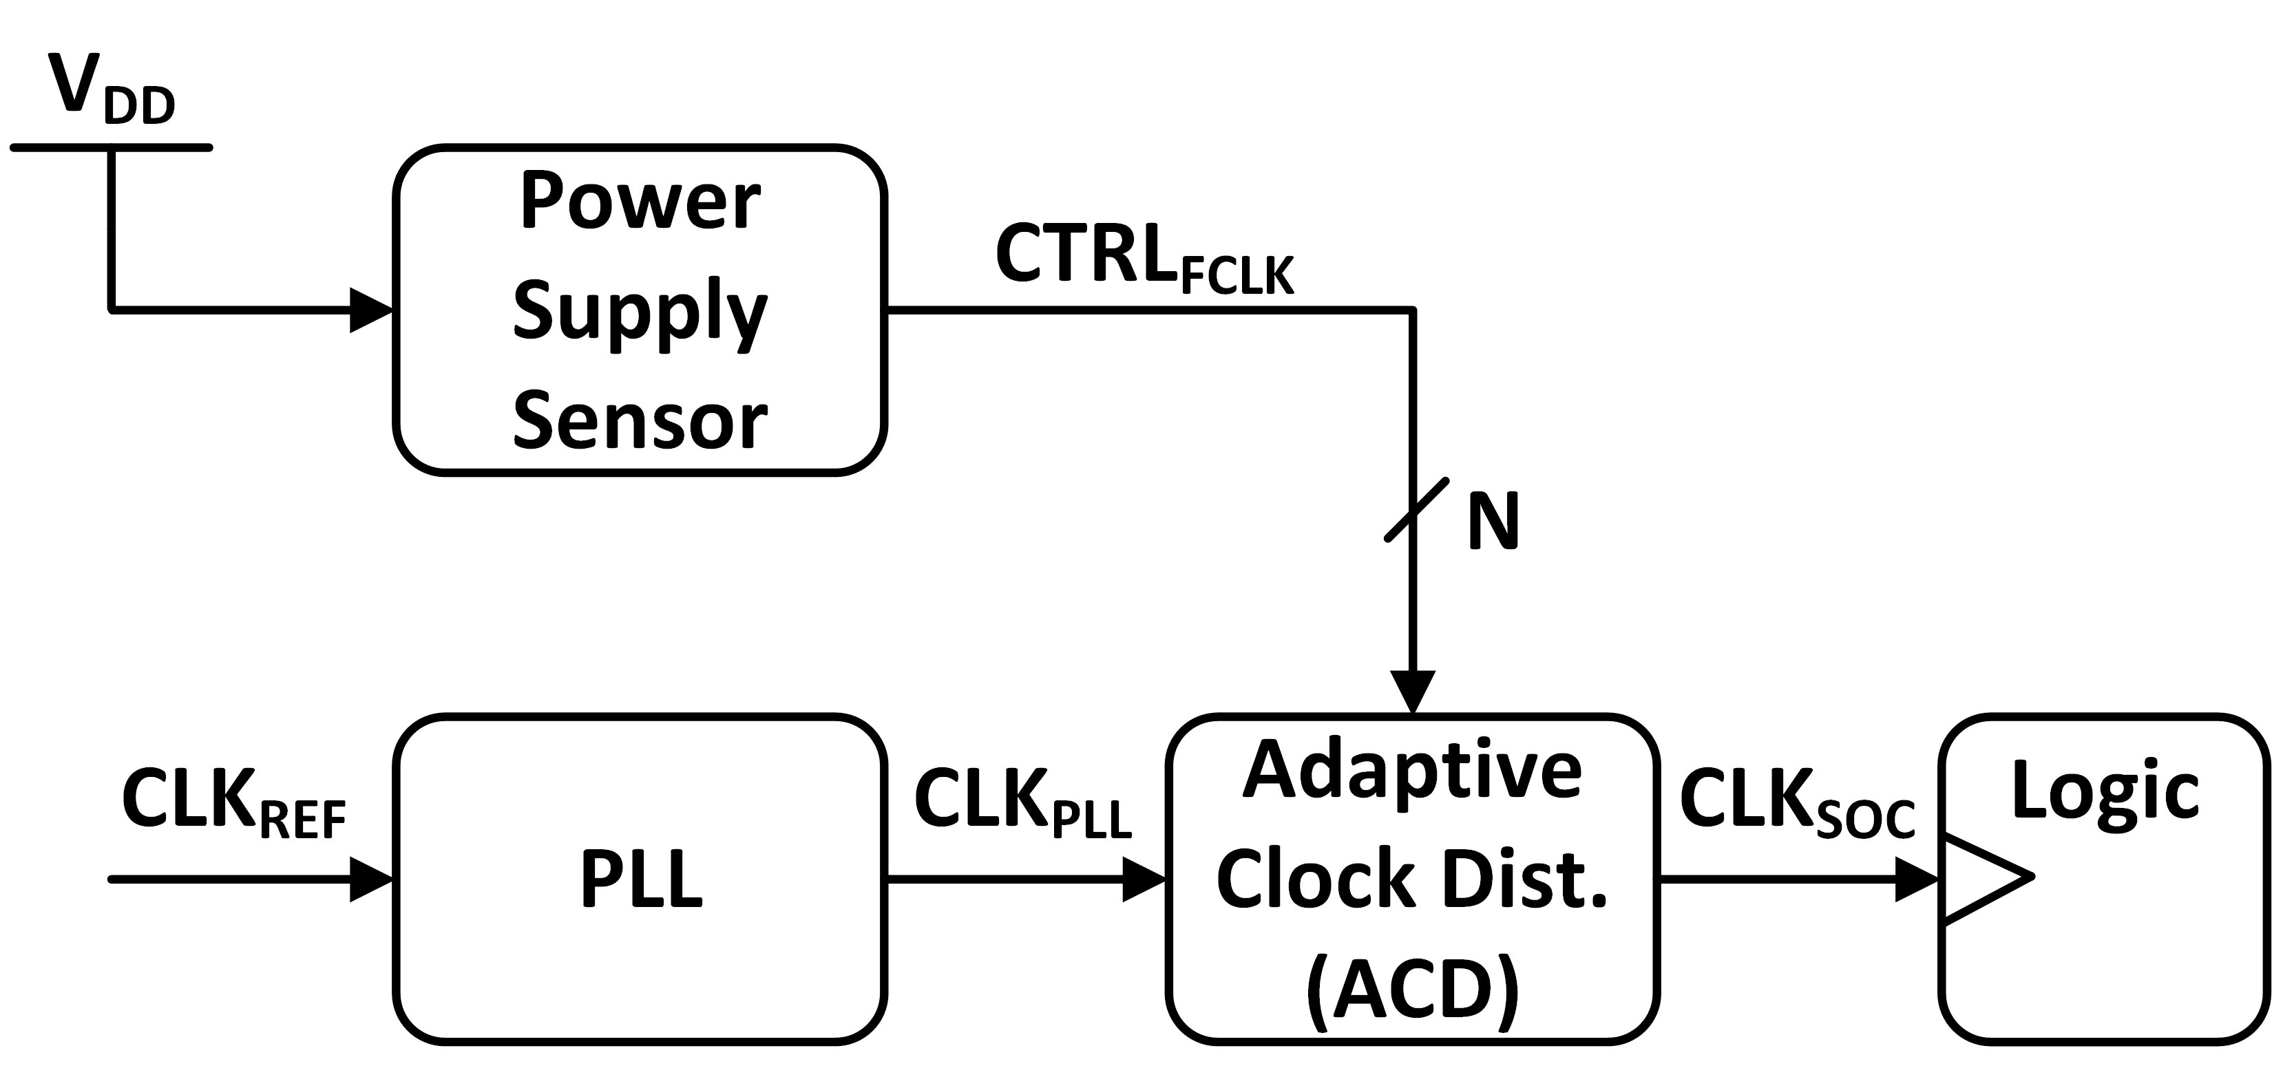
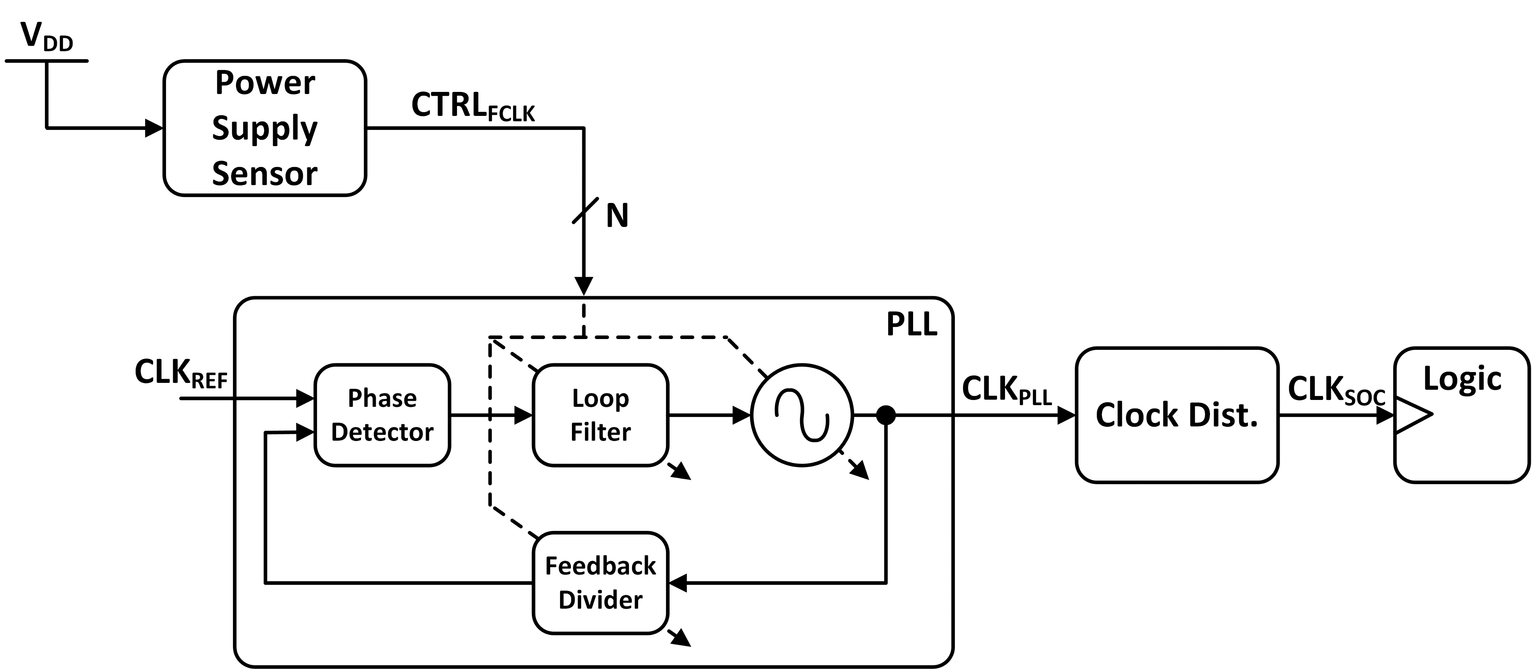
Adaptive Clocking Schemes
Power supply sensor detects V_{DD} change
Clock distribution (post-PLL) adjusts clock frequency by extending period
E.g. Phase rotators, tunable delay line
Power supply sensor detects V_{DD} change
PLL internally adjusted for frequency
E.g. direct override of VCO, loop filter, divider
Actuation latency (i.e. adaptation time) is a key metric

Slide 5
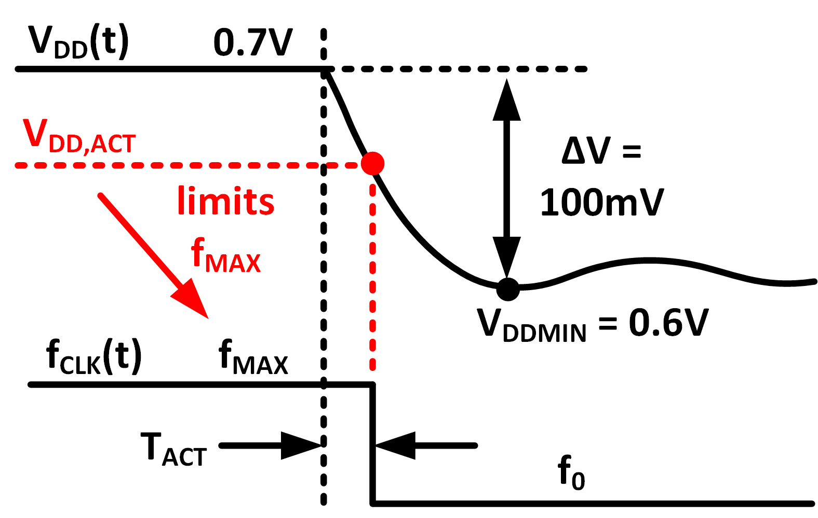
Actuation Latency Penalty
Longer T_{ACT} → lower V_{DD,ACT} → lower f_{MAX}
At fixed V_{DD}:
Longer T_{ACT} → lower V_{DD,ACT} → higher V_{MIN}
At fixed f_{MAX}:

Slide 6
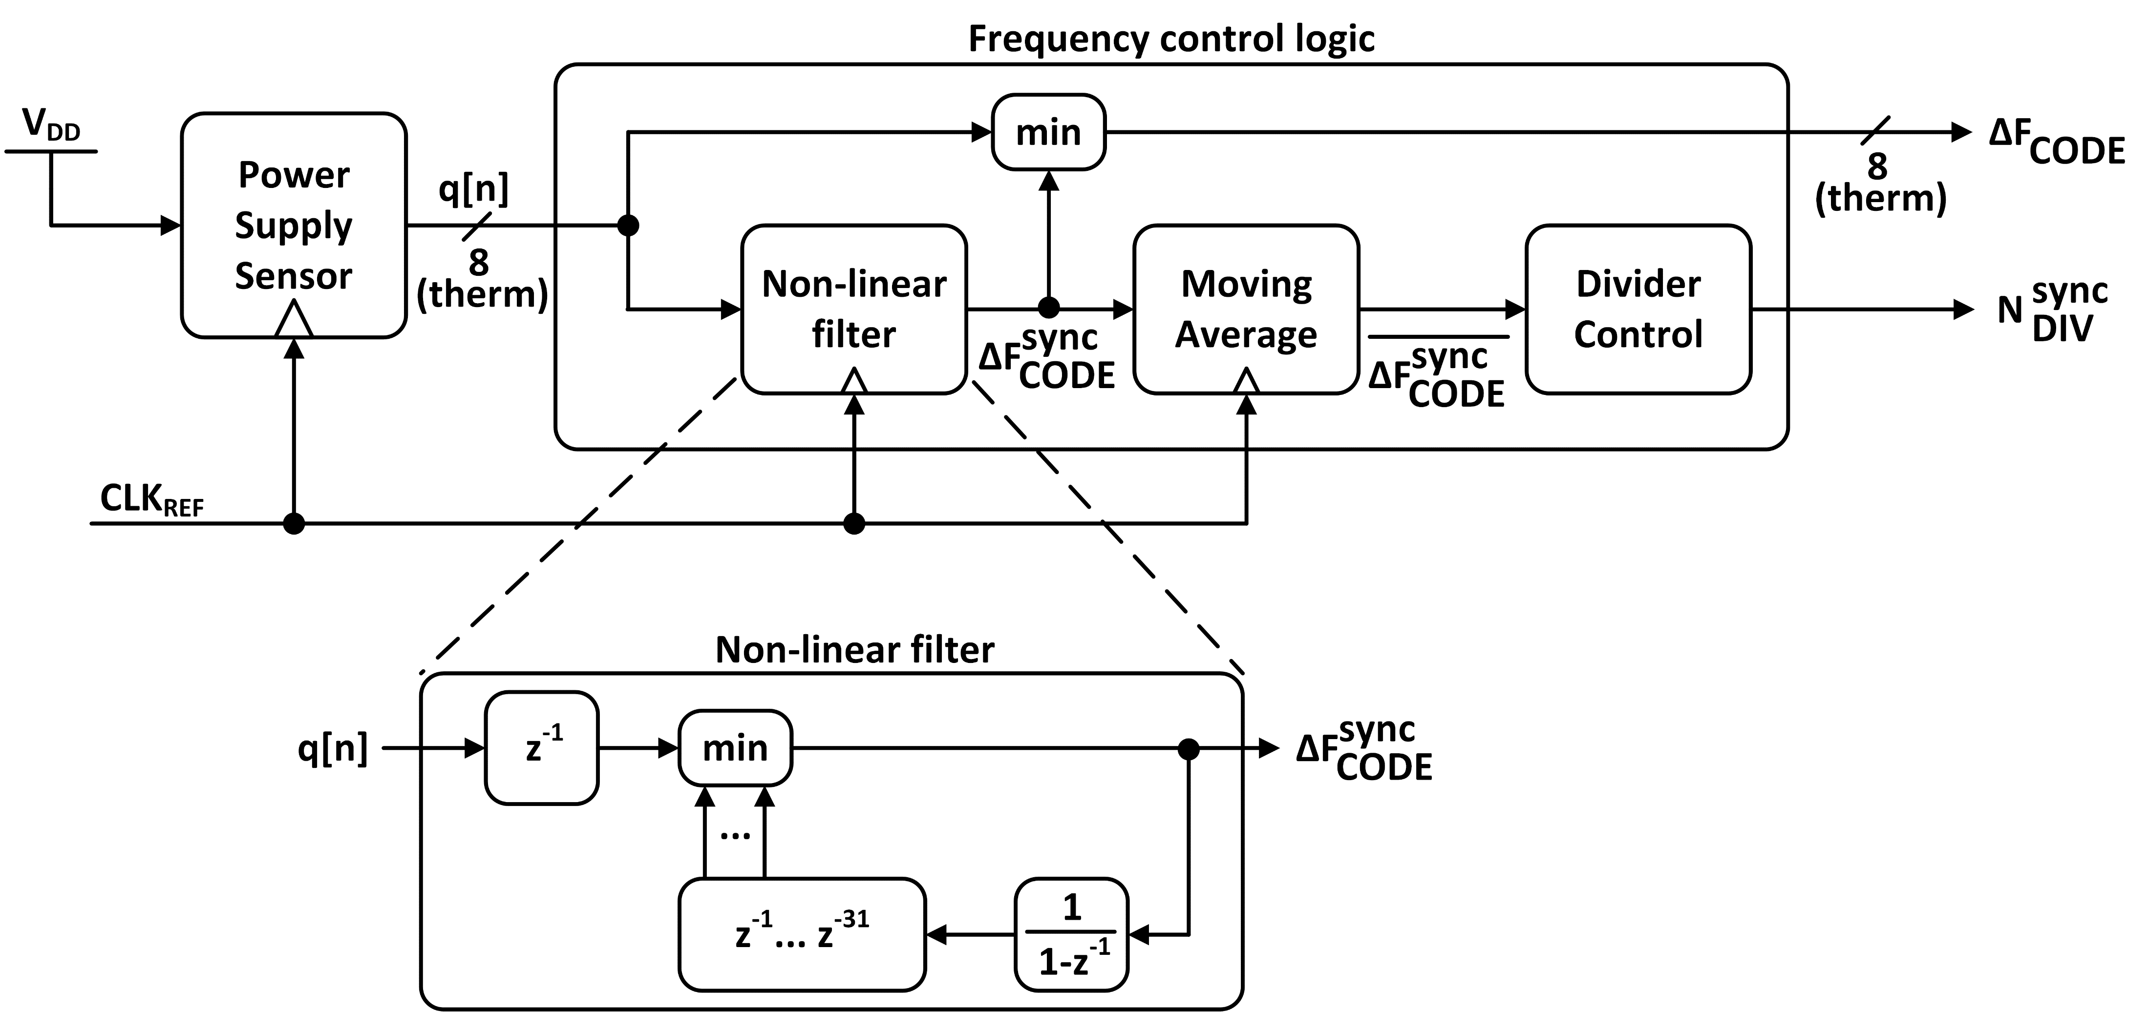
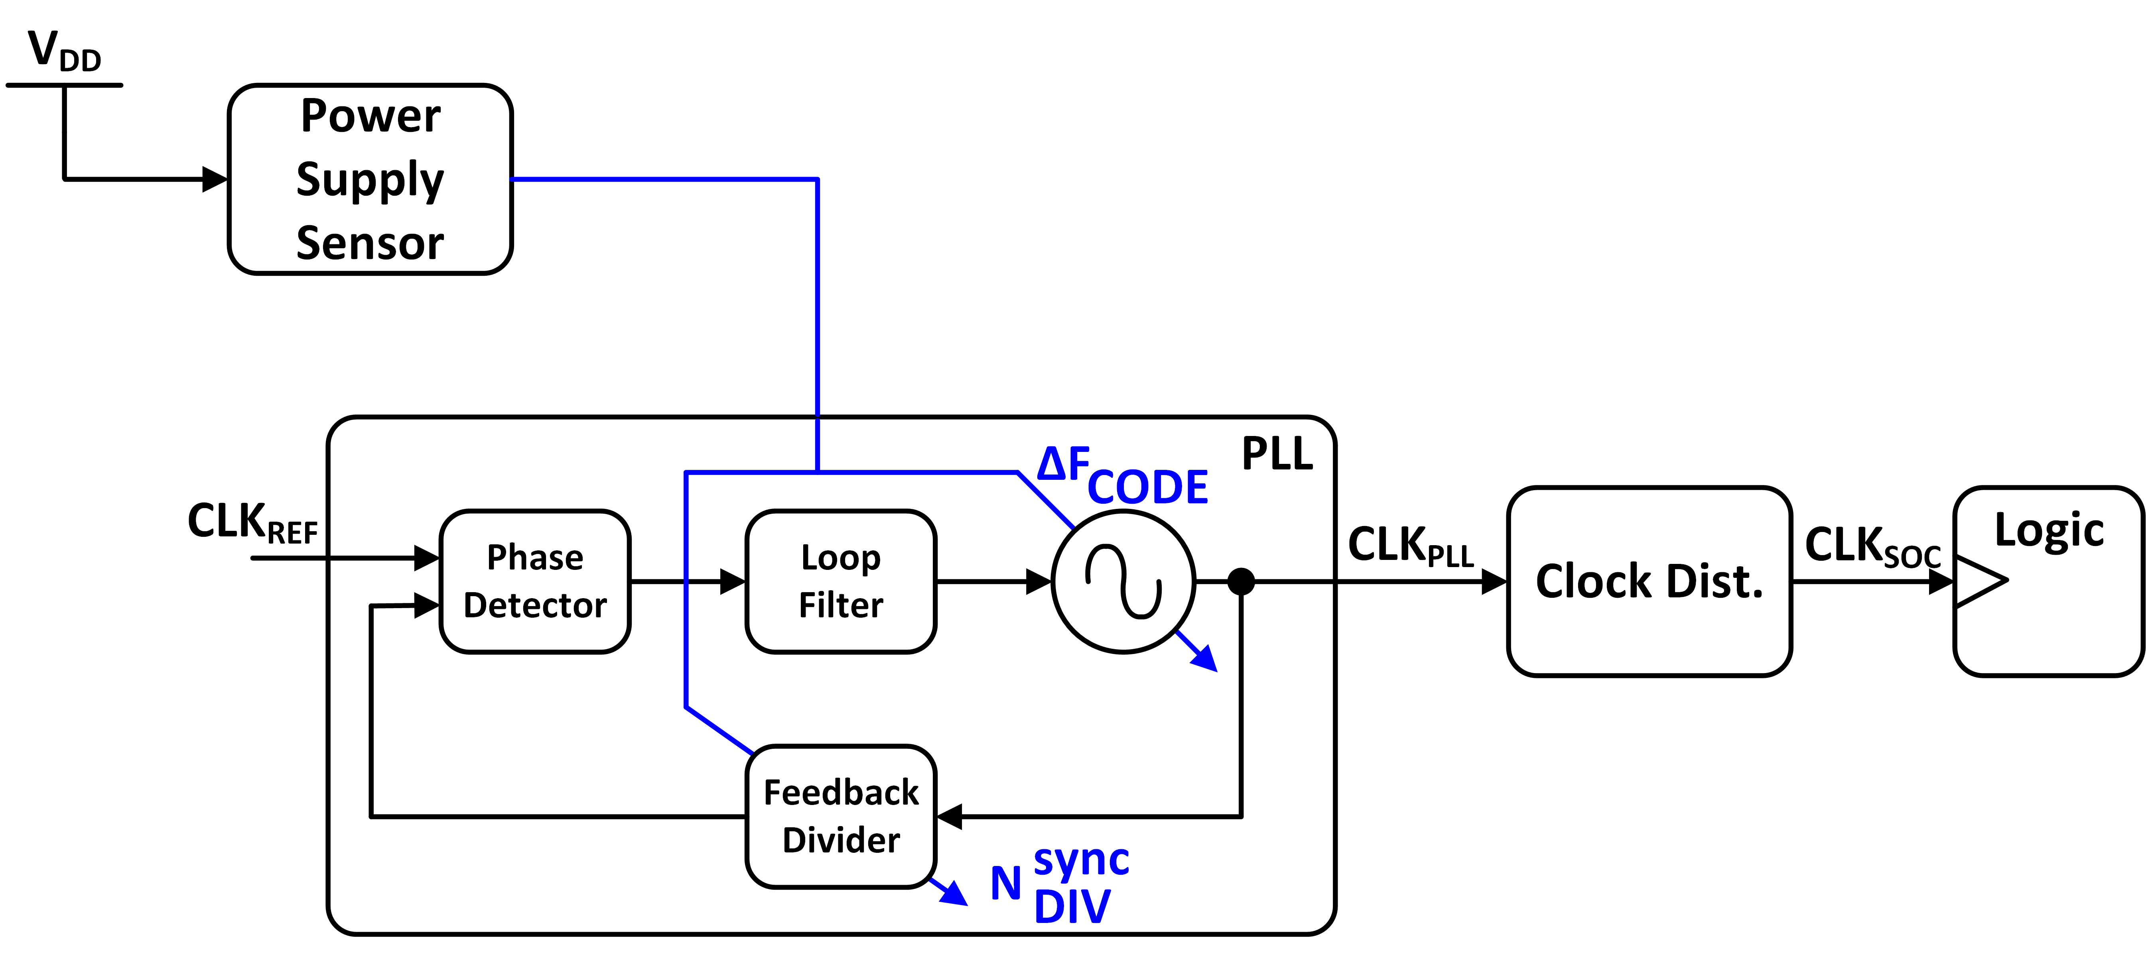
PLL-based adaptive clocking
T. Hashimoto et al. JSSC 2015

